Slide 1
No Readmission
Ramesh Kattumenu
Data Scientist

Slide 2
Ride Along….

Slide 3
Part 1 The Boring Numbers!

Slide 4
Readmission
Notes:
A patient is determined to be at high-risk for readmission, if a return trip to the hospital could be prevented by providing additional interventions such as a home visit by a nurse or pharmacist consultation

Slide 5
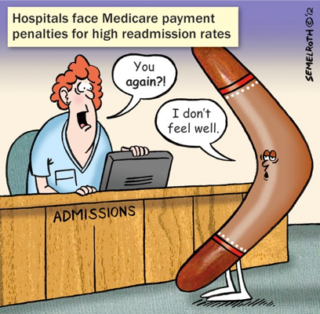
Importance
Hospital Readmission Reduction Program (HRRP)
Hospital readmissions cost ~17 billion annually*
*ref-CHIA

Slide 6
Objective
To design a prediction model for potentially avoidable 30-day readmissions in medical patients using administrative and clinical data available prior to discharge

Slide 7
Factors for readmission
Features
Age
Gender
Race
Admission Type
Time in Hospital
Diagnosis
In patient visits
Discharge Type
To home
Transferred to another short term hospital
To another hospital for neonatal aftercare
Transferred to critical access hospital
Transferred to federal healthcare facility
Emergency
Urgent care
Elective
Newborn
Trauma Center
Circulatory
Respiratory
Diabetes
Neoplasm
Other
0-9
10-19
20-29
30-39
40-49
Notes:
Next slide is Tableau EDA

Slide 8
Part 2 The Visuals!

Slide 9
Part 3 The Model! And my conversation with it!!!

Slide 10
Model Performance
Accuracy = 90%

Slide 11
Model Performance
Orange | Apple
90 | 10
Orange | Apple
100 | 0
Accuracy = 90%

Slide 13
The ROC Curve

Slide 14
The Confusion Matrix!!
 |  | Predicted
 |  | Orange | Apple
Actual | Orange | 90 | 0
 | Apple | 0 | 10
 |  | Predicted
 |  | Free Bird | Readmit
Actual | Free Bird | TN | FP
 | Readmit | FN | TP
 |  | Predicted
 |  | Orange | Apple
Actual | Orange | 63 | 27
 | Apple | 8 | 2

Slide 15
Free Bird class
Readmits class
Free Bird
Readmit
Readmit
Free Bird
Classification Report
 | precision | recall | f1-score | Support
Free bird | 0.89 | 1.0 | 0.94 | 26494
 | 0.5 | 0.01 | 0.02 | 3312
Readmit
Avg | 0.85 | 0.89 | 0.84 | 29806
Threshold = 0.5 |  | Predicted
 |  | Free Bird | Readmit
Actual | Free Bird | 26466 | 28 | 26494
 | Readmit | 3284 | 28 | 3312
 |  | 29750 | 56 | 29806

Slide 16
Free Bird class
Readmits class
Free Bird
Free Bird
Readmit
Readmit
Readmit
Free Bird
Readmit
Free Bird
Classification Report
 | precision | recall | f1-score | Support
Free bird | 0.89 | 1.0 | 0.67 | 26494
 | 0.15 | 0.70 | 0.25 | 3312
Readmit
Avg | 0.84 | 0.88 | 0.85 | 29806
Classification Report
 | precision | recall | f1-score | Support
Free bird | 0.89 | 1.0 | 0.94 | 26494
 | 0.50 | 0.01 | 0.02 | 3312
Readmit
Avg | 0.85 | 0.89 | 0.84 | 29806
Threshold = 0.5 |  | Predicted
 |  | Free Bird | Readmit
Actual | Free Bird | 26466 | 28 | 26494
 | Readmit | 3284 | 28 | 3312
 |  | 14829 | 14977 | 29806
Classification Report
 | precision | recall | f1-score | Support
Free bird | 0.93 | 0.52 | 0.67 | 26494
 | 0.15 | 0.70 | 0.25 | 3312
Readmit
Avg | 0.85 | 0.54 | 0.62 | 29806
Threshold = 0.1 |  | Predicted
 |  | Free Bird | Readmit
Actual | Free Bird | 26466 | 28 | 26494
 | Readmit | 993 | 2319 | 3312
 |  | 27459 | 2347 | 29806
Classification Report
 | precision | recall | f1-score | Support
Free bird | 0.93 | 0.52 | 0.67 | 26494
 | 0.15 | 0.70 | 0.25 | 3312
Readmit
Avg | 0.85 | 0.54 | 0.62 | 29806
Threshold = 0.1 |  | Predicted
 |  | Free Bird | Readmit
Actual | Free Bird | 13836 | 12658 | 26494
 | Readmit | 993 | 2319 | 3312
 |  | 14829 | 14977 | 29806
Threshold = 0.1 |  | Predicted
 |  | Free Bird | Readmit
Actual | Free Bird | 13836 | 12658 | 26494
 | Readmit | 993 | 2319 | 3312
 |  | 14829 | 14977 | 29806

Slide 17
Limitations
Patients who died within 30 days of discharge were excluded because predictors of death may be somewhat different than predictors of readmission
Readmissions to non-study hospitals were not included, and patients are known to underreport hospital readmissions.
The model does not include drug effects post discharge and is an important patient outcome for readmission.
Generic markers of illness may be less predictive when evaluating medical conditions in contrast to disease-specific markers.

Slide 18
Improvements to the model
Adjustments to fines based on patients’ supplemental security income.
Penalties weights based on the timing of readmissions (i.e. a three-day readmission would be weighted more heavily than a 20-day readmission); and
Credits for low readmission rates.

Slide 19
Conclusions
Hospital readmissions were predicted using available administrative and clinical data.
The model’s 70% predictive capability to identify patients readmission comes at the expense of predicting non readmissions as readmissions.
There is a higher chance of being readmitted if the patient has been initially diagnosed with circulatory diseases or diabetes, within the age group of 50-60.
There is also higher chance of readmission if the initial visit was to an emergency facility due to injury.

Slide 20
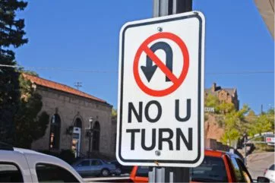
Don’t Look Back

Slide 22
Live Healthy and Die Peacefully

Slide 23
Specific Interventions
Medication reconciliation: Within 48 hours of discharge, a physician reviews a list of the patient’s medications with explicit instructions to the patient about how to properly take them.
Post-discharge appointments: Before being discharged, nurses schedule patients for follow-up care. When possible, patients at high risk for readmission are scheduled to be seen within seven days of discharge.
Post-discharge phone calls: Within a specified time frame following discharge, a member from the care team calls patients to assess their condition and answer any questions.

Slide 24
Predicted Probability and Thresholds
Class 0 (free bird) | Class 1 (readmit) | Threshold(=0.5) | Threshold(=0.1)
0.937 | 0.062 | 0 | 0
0.908 | 0.091 | 0 | 0
0.941 | 0.058 | 0 | 0
0.886 | 0.113 | 0 | 1
0.910 | 0.089 | 0 | 0
0.954 | 0.045 | 0 | 0
0.901 | 0.098 | 0 | 0
0.868 | 0.131 | 0 | 1
0.920 | 0.079 | 0 | 0
0.925 | 0.074 | 0 | 0

Slide 25
May be remove this

Slide 26
"A patient is determined to be at high-risk for readmission, if a return trip to the hospital could be prevented by providing additional interventions such as a home visit by a nurse or pharmacist consultation,"

Slide 27
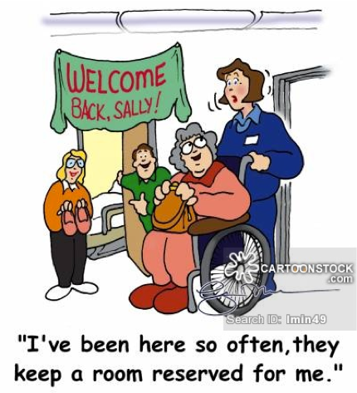
Relevance: The model has potential to identify patients who may need more intensive transitional care interventions.

Slide 28
S.NO | Features | Datatype
1 | Race | Categorical
2 | Gender | Categorical
3 | Age | Categorical
4 | Admission_type_id | Numerical
5 | Discharge_disposition_id | Numerical
6 | Admission_source_id | Numerical
7 | Time_in_hospital | Numerical
8 | Num_lab_procedures | Numerical
9 | Num_procedures | Numerical
10 | Num_medications | Numerical
11 | Num_outpatient | Numerical
12 | Num_emergency | Numerical
13 | Num_inpatient | Numerical
14 | Code 1 | Categorical
15 | Code 2 | Categorical
16 | Code 3 | Categorical
17 | Number_diagnosis | Numerical
18 | max_glu_serum | Categorical
19 | A1Cresult | Categorical
20 | insulin | Categorical
21 | change | Categorical
22 | DiabetesMed | Categorical
Target | Readmitted | Categorical
001–139: infectious and parasitic diseases
140–239: neoplasms
240–279: endocrine, nutritional and metabolic diseases, and immunity disorders
280–289: diseases of the blood and blood-forming organs
290–319: mental disorders
320–359: diseases of the nervous system
360–389: diseases of the sense organs
390–459: diseases of the circulatory system
460–519: diseases of the respiratory system
520–579: diseases of the digestive system
580–629: diseases of the genitourinary system
630–679: complications of pregnancy, childbirth, and the puerperium
680–709: diseases of the skin and subcutaneous tissue
710–739: diseases of the musculoskeletal system and connective tissue
740–759: congenital anomalies
760–779: certain conditions originating in the perinatal period
780–799: symptoms, signs, and ill-defined conditions
800–999: injury and poisoning
X,'E' codes – external causes of injury
Y,'V' codes – Supplementary classification of factors influencing health status and contact with health services

Slide 29
Free Bird class
Readmits class
Free Bird
Readmit
Readmit
Free Bird
Free Bird
Readmit
Readmit
Free Bird

